Slide 1
Retail Sales & Profit Analysis Project

Slide 2
agenda
Project Objective
Dataset Overview
Data Cleaning (Python)
Exploratory Data Analysis
SQL Analysis
Power BI Dashboard
Conclusion & Future Scope

Slide 3

Project Objective The objective of this project is to analyze historical retail sales data using SQL, Python, and Power bi to uncover actionable business insights. The analysis focuses on understanding sales performance, profitability trends, customer segments, regional demand, and the impact of discounts and shipping delays. By combining data cleaning, exploratory analysis, and interactive dashboarding, the project aims to help stakeholders make informed decisions to improve marketing, operations, and inventory planning.

Slide 4

2 .Dataset Overview
This dataset provides a complete view of retail operations from sales and shipping to customer segments and product performance.
By analyzing it, we can uncover which areas are profitable, which products underperform, and how shipping delays or discounts affect business outcomes.

Slide 5
Data Cleaning (Python)
I removed duplicate records, verified there were no missing values , converted date columns to proper datetime format, and created a new column called date_diff to measure shipping delay.
I use the mean , median , varience etc to understand the distribution and spread of data .
Use of the pandas seaborn numpy and matplotlib I draw the graph for better understanding histogram , barchart and also use of group by to understand data in deep by applying grouping of data .
There was some duplicated values and null values also I fixed it using fillna and drop duplicated .

Slide 6
Exploratory Data Analysis
Once the data was cleaned, I performed exploratory data analysis to uncover Patterns and trends within the dataset.
I started by analyzing the distribution of key variables such as sales, profit, discount, and quantity using histograms and boxplots.
Using groupby() operations , I compare performance across different regions segment and categories.
I visualized relationships using scatter plots for example , how higher discounts often led to lower profits.
Line charts were used to track trends over time , while bar charts helped compare categorical features like sub-categories or states.
These insights laid the foundation for deeper SQL queries and interactive dashboarding in power BI.

Slide 7
SQL Analysis
Queried total sales and profit by Region and State to identify high-performing areas.
Found top 10 profitable products and least profitable sub – categories .
Identified top 5 customers by total revenue .
Used the joins and group by to combine and aggregate and product and sales data .
Detected the shipping delay using the date_diff column to flag slow deliveries .
Created custom views or CTEs (Common Table Expressions ) for reuse in complex queries .
Using aggregation, filtering, and time functions, I created powerful summaries that directly feed into Power BI for dashboarding."

Slide 8
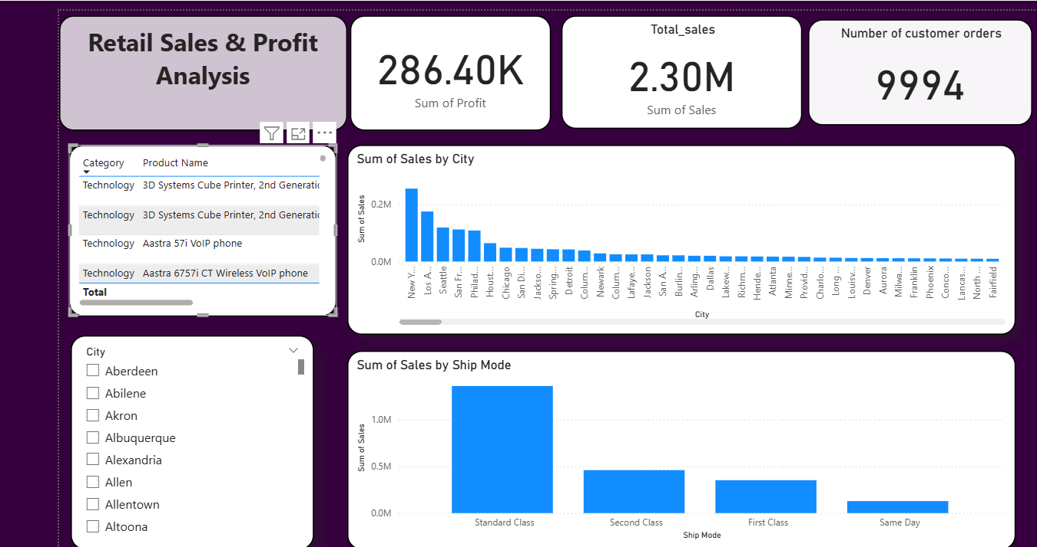
Power BI Dashboard

Slide 9

Conclusion & Future Scope
Performed complete data analysis workflow using Python, SQL, and Power BI.
Cleaned and prepared the dataset (duplicates, dates, missing values).
Conducted exploratory data analysis to understand trends in sales, profit, and shipping .
Used SQL to extract deeper insights and validated Python results .
Created an interactive dashboard using Power BI for real-time decision-making .
Add machine learning models for predicting sales, profit, or customer churn .
Integrate real-time data pipelines for live analytics dashboards .
Deploy analysis on cloud platforms like AWS or Azure for scalability .
Automate report generation and alerts using Python scripts or Power BI subscriptions .

Slide 10
Thank you

